Slide 1
ACM MM 2013
Analysis and Forecasting of Trending Topics in Online Media Streams
Tim Althoff, Damian Borth, Jörn Hees, Andreas Dengel German Research Center for Artificial Intelligence (DFKI)
ALL RIGHTS RESERVED. No part of this work may be reproduced in any form or by any means, electronic or mechanical, including photocopying,
recording, or by any information storage and retrieval system without expressed written permission from the authors.
Notes:
1

Slide 2
Motivation
Notes:
This is what the world looks like if you have worked on social media analysis before. Many things I do or I'm interested in are reflected in my actions that I take online.
When I want to buy a new car I google certain models and manufacturers, I reach out to some friends over online social networks. I watch videos about the cars because I want to get an impression what they look and sound like.
What I am trying to motivate here is that my interests and intentions drive my behavior online. Turning this around, online behavior becomes indicative of my current and future situations and interests.
Let's take a look at how much activity actually happens online that we could use to infer such interests.
2

Slide 3
Large-scale Record of Human Behavior
Primary method for communication by college students in the U.S.
340 million tweets each day by 500 million users
One billion search requests and about twenty petabytes of user-generated data each day (2009)
Notes:
Twitter users in New York city were seeing tweets about the 2011 Washington D.C. earthquake half a minute before they could even feel it

Slide 4
Motivation
People use the web for news, information, and communication
Online activity becomes indicative of the interests of the global population
„Mirror of Society“
[Steven Van Belleghem, 2012]
Notes:
4

Slide 5
Use Cases of Online Activity

Slide 6
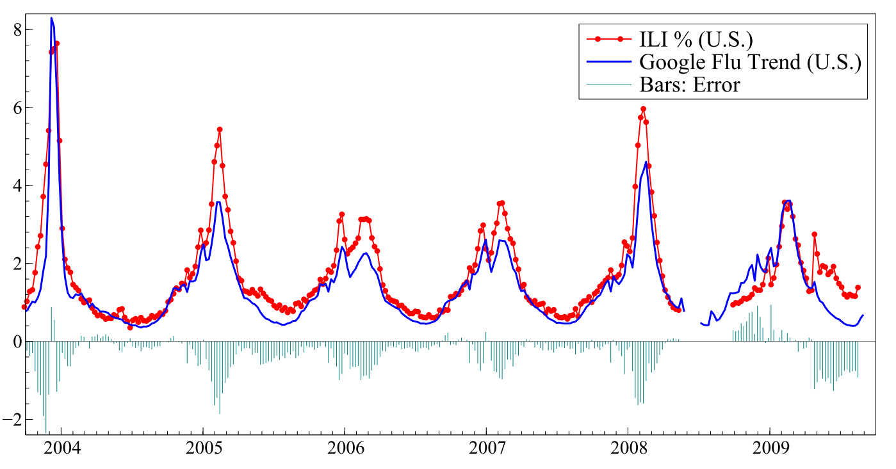
Tracking Flu Infections
flu remedy
[Ginsberg et al. Detecting influenza epidemics using search engine query data. Nature. 2008.]

Slide 7
Relevance for the MM Community
Panel: Cross-Media Analysis and Mining
Focus more on the time dimension
How do topics of interest develop over time?

Slide 8
Relevance for the MM Community
Panel: Cross-Media Analysis and Mining
Focus more on the time dimension
How do topics of interest develop over time?
Trend aware recommendation systems
Automatic vocabulary selection for classification

Slide 9
Shortcomings of Related Work
Focus on very specific use cases (e.g. flu)
Nowcasting instead of forecasting
Manual correlation analysis instead of fully automatic forecasting
No comparison/study of different online & social media channels wrt. emerging trends
[Choi and Varian. Predicting initial claims for unemployment benefits. Google, Inc. 2009.] [Choi and Varian. Predicting the Present with Google Trends. Economic Record, 2012.] [Ginsberg et al. Detecting influenza epidemics using search engine query data. Nature. 2008.] [Cooper et al. Cancer internet search activity on a major search engine. Journal of medical Internet research, 2005.] [Goel et al. Predicting consumer behavior with web search. National Academy of Sciences, 2010.] [Jin et al. The wisdom of social multimedia: using Flickr for prediction and forecast. ACM MM 2010.] [Adar et al. Why we search: visualizing and predicting user behavior. WWW, 2007.]
Notes:
9

Slide 10
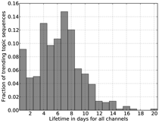
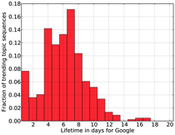
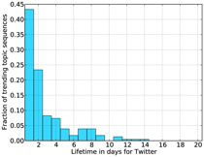
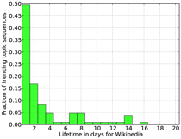
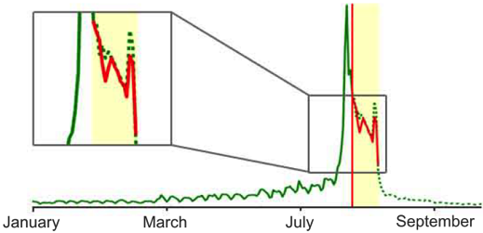
Goals
Multi-channel analysis of trending topics
Fully automatic forecasting of trending topics
Notes:
Emphasize that we focus on forecasting in this talk while we did more analysis (see thesis)
10

Slide 11
Goals
Multi-channel analysis of trending topics
Fully automatic forecasting of trending topics
Notes:
Emphasize that we focus on forecasting in this talk while we did more analysis (see thesis)
11

Slide 12
Trending Topics

Slide 13
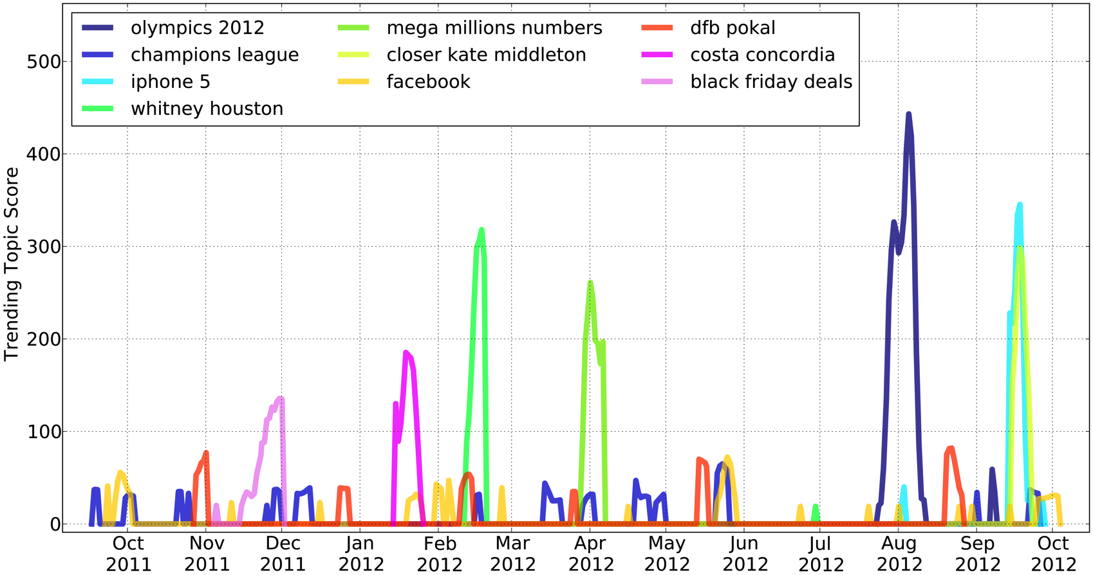
Trending Topics
A trending topic
is a subject matter of discussion agreed on by a group of people
experiences a sudden spike in user interest or engagement

Slide 14
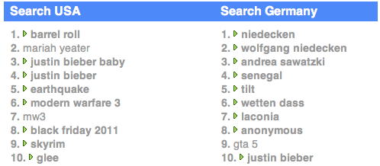
Trending Topics Discovery
Daily crawling of 10 sources
Capturing
Communication needs (Twitter)
Search patterns (Google)
Information demand (Wikipedia)
Search Germany
News Germany
Trends
News USA
Search USA
Trends USA
German Wikipedia
Daily Trends
Trends Germany
English Wikipedia
[Damian Borth, Adrian Ulges, Thomas Breuel. Dynamic Vocabularies for Web-based Concept Detection by Trend Discovery. ACM Multimedia, 2012]
Google

Slide 15
Trending Topics Discovery
Daily crawling of 10 sources
Capturing
Communication needs (Twitter)
Search patterns (Google)
Information demand (Wikipedia)
Search Germany
News Germany
Trends
News USA
Search USA
Trends USA
German Wikipedia
Daily Trends
Trends Germany
English Wikipedia
Dataset
Observation period
Sept. 2011 – Sept. 2012
40,000 items analyzed
~ 3,000 trending topics discovered
[Damian Borth, Adrian Ulges, Thomas Breuel. Dynamic Vocabularies for Web-based Concept Detection by Trend Discovery. ACM Multimedia, 2012]
Google

Slide 16
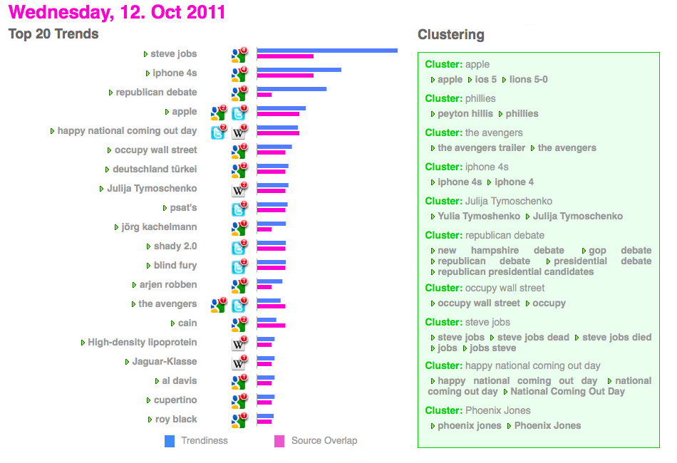
Trending Topics Discovery
Notes:
16

Slide 17
Trending Topics Discovery
Notes:
17

Slide 18
Goals
Multi-channel analysis of trending topics
Fully automatic forecasting of trending topics
Notes:
Emphasize that we focus on forecasting in this talk while we did more analysis (see thesis)
18

Slide 19
Multi-Channel Analysis

Slide 20
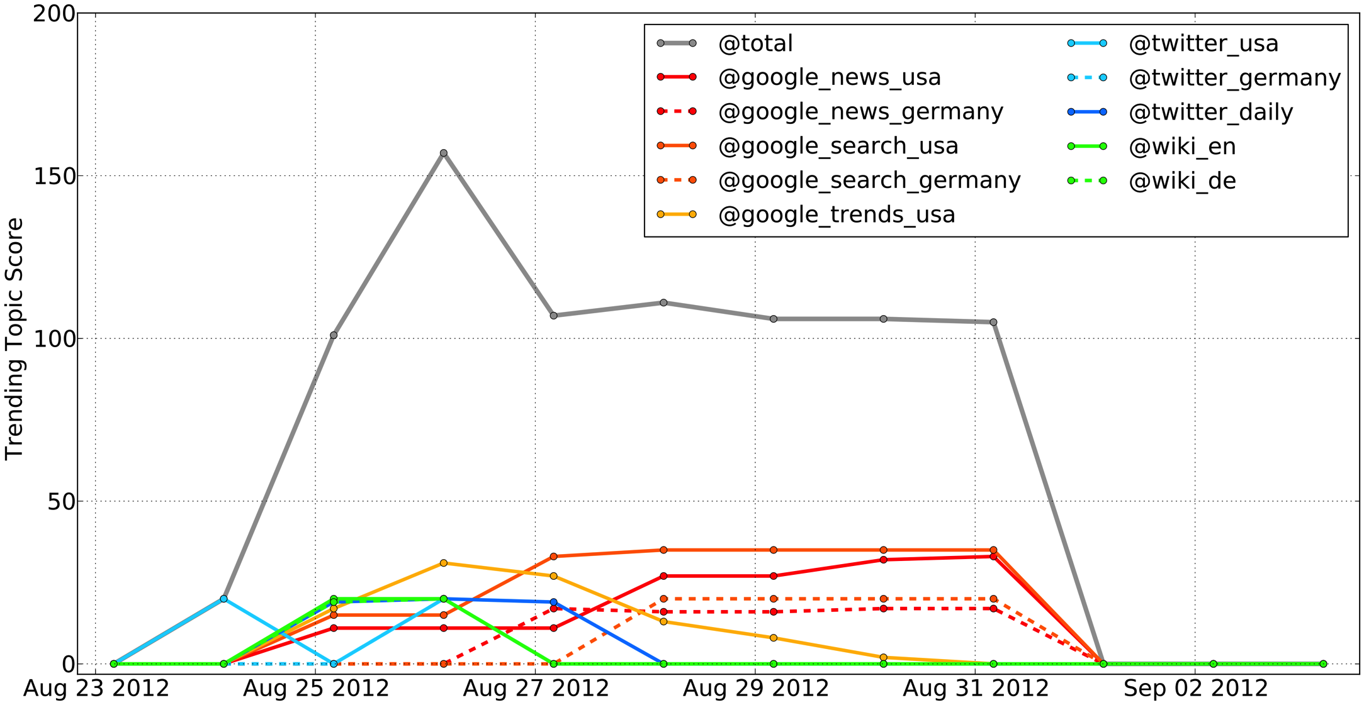
Example
Neil Armstrong died on August 25, 2012.
Notes:
20

Slide 21
Lifetime Analysis
Notes:
21

Slide 22
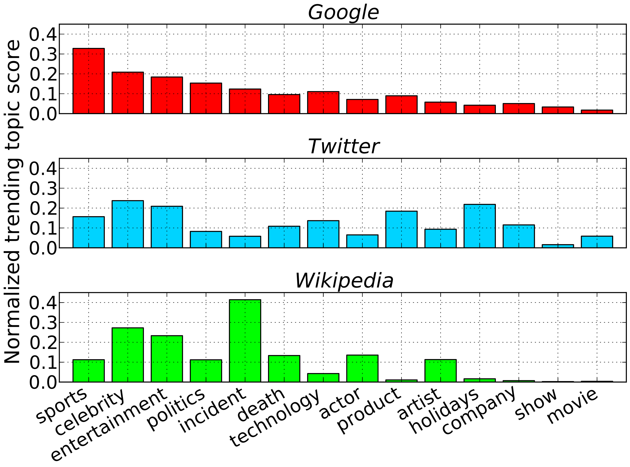
Topic Category Analysis
Notes:
22

Slide 23
Topic Category Analysis
Notes:
23

Slide 24
Topic Category Analysis
Notes:
24

Slide 25
Topic Category Analysis
Notes:
25

Slide 26
Forecasting

Slide 27
Forecasting
time
observed values
forecast
Notes:
Forecasting is the process of making statements about events whose actual
outcomes (typically) have not yet been observed. In the context of time series,
this means predicting future values of the time series.
Y-axis could be anything such as views/clicks/queries
27

Slide 28
Basic Forecasting Techniques
Naive
Linear Trend
Average/Median
ARMA
Nearest Neighbor
Notes:
28

Slide 29
Basic Forecasting Techniques
Naive
Linear Trend
Average/Median
ARMA
Nearest Neighbor
Notes:
29

Slide 30
Basic Forecasting Techniques
Naive
Linear Trend
Average/Median
ARMA
Nearest Neighbor
Notes:
30

Slide 31
Basic Forecasting Techniques
Naive
Linear Trend
Average/Median
ARMA
Nearest Neighbor
Notes:
ARMA IS STATE OF THE ART!!!
Auto Regressive (Integrated) Moving Average
31

Slide 32
Basic Forecasting Techniques
Naive
Linear Trend
Average/Median
ARMA
Nearest Neighbor
Notes:
32

Slide 33
Example Signal
Notes:
More emphasis, play with laser pointer
33

Slide 34
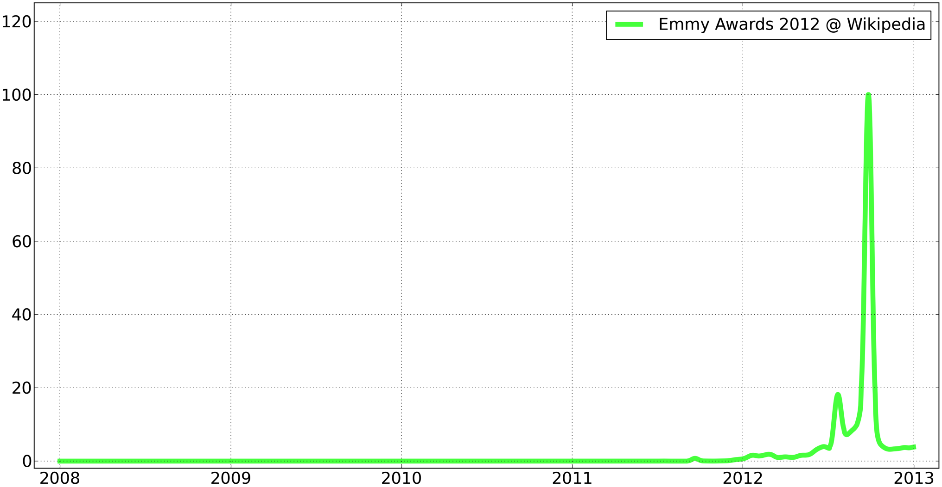
Forecasting Can Be Very Challenging
Notes:
Challenging problem – NO history!
This is not even the most extreme example! When Michael Jackson or Whitney Houston died suddenly over 5 million people accessed their Wikipedia page → a 2000x fold increase
34

Slide 35
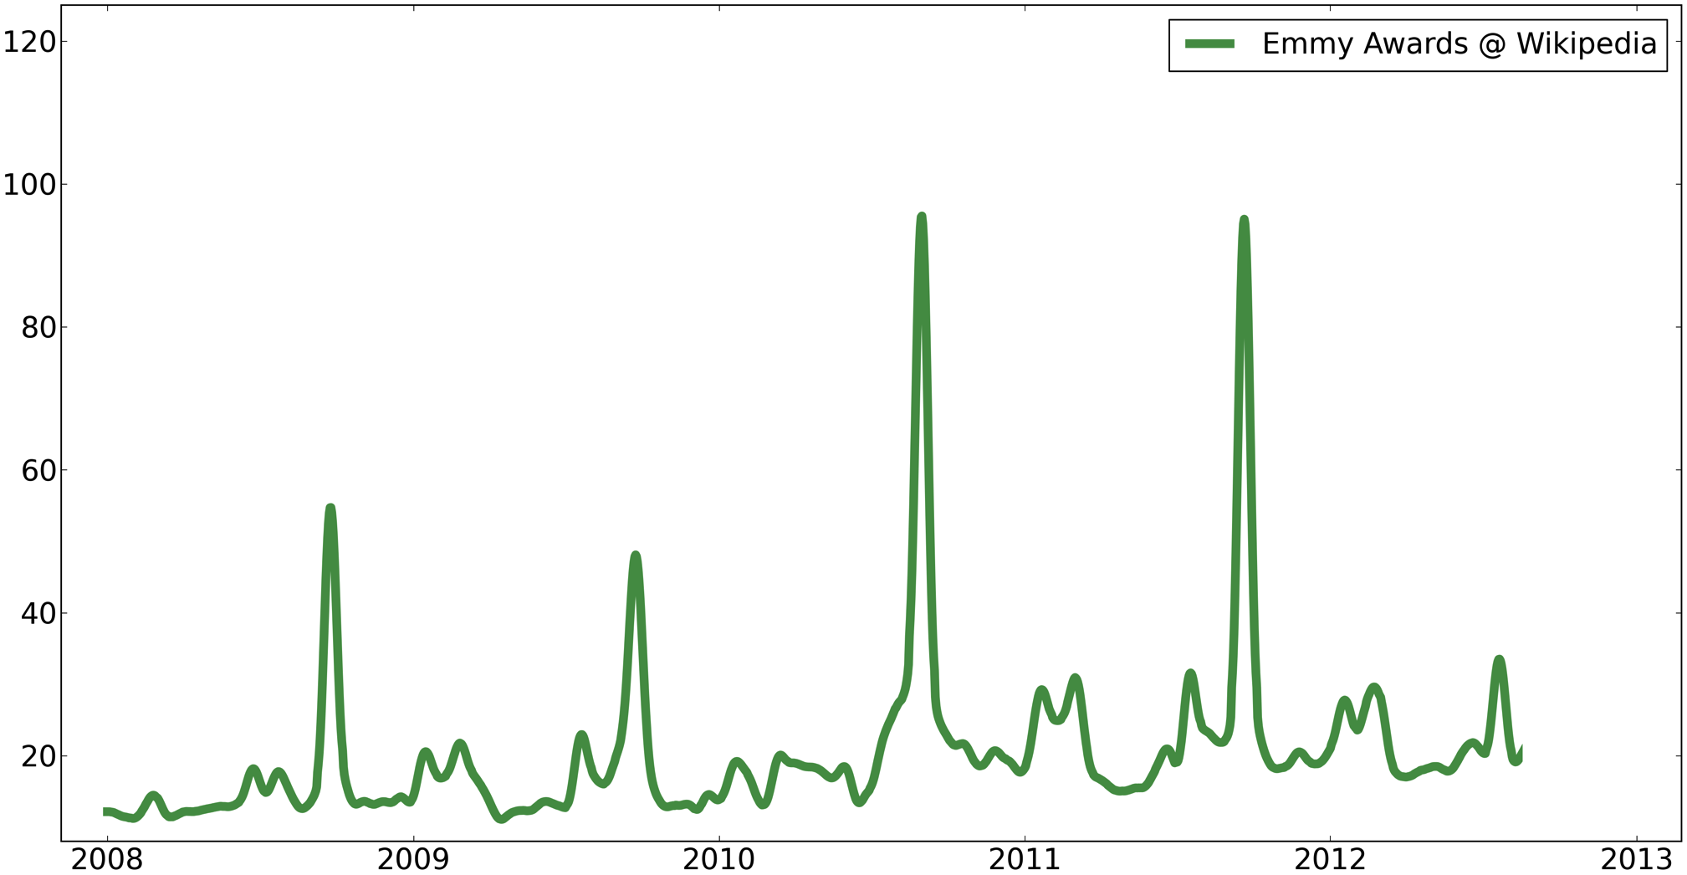
Recurring Signal
Notes:
35

Slide 36
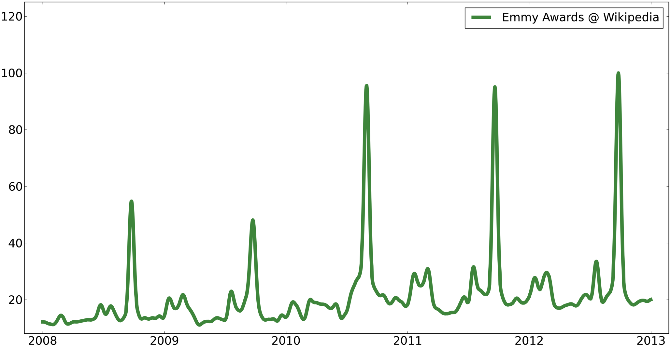
Recurring Signal
Notes:
36

Slide 37
What To Do In This Case?
Notes:
Challenging problem – NO history!
This is not even the most extreme example! When Michael Jackson or Whitney Houston died suddenly over 5 million people accessed their Wikipedia page → a 2000x fold increase
37

Slide 38
What To Do In This Case?
Semantics!
Notes:
Challenging problem – NO history!
This is not even the most extreme example! When Michael Jackson or Whitney Houston died suddenly over 5 million people accessed their Wikipedia page → a 2000x fold increase
38

Slide 39
Use Semantically
Similar Topics

Slide 40
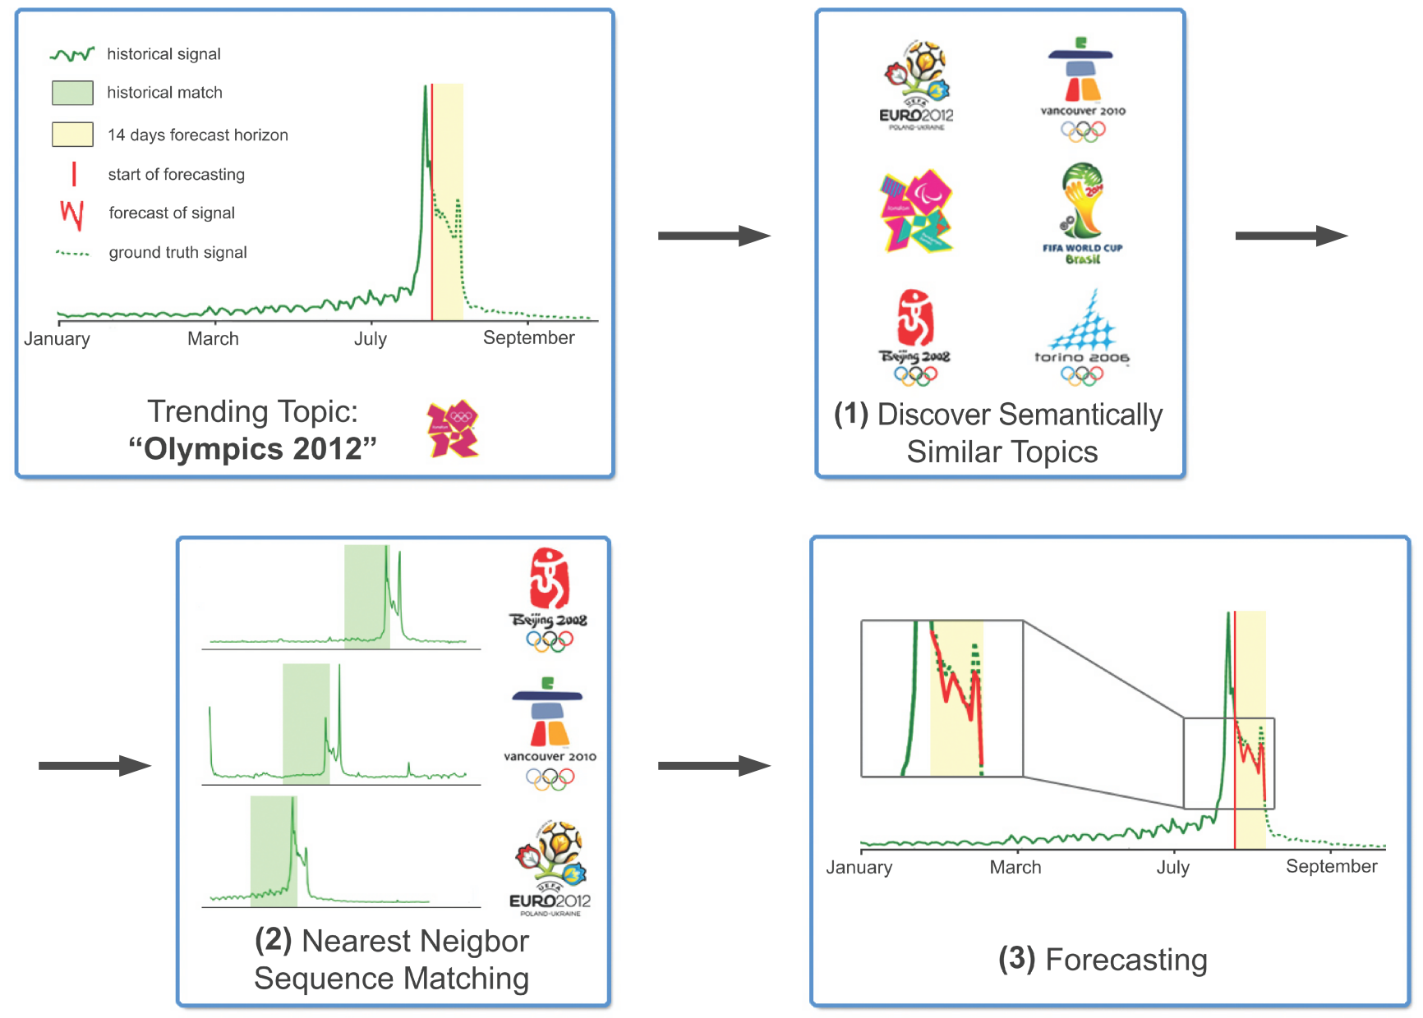
Approach

Slide 41
Approach

Slide 42
Approach

Slide 43
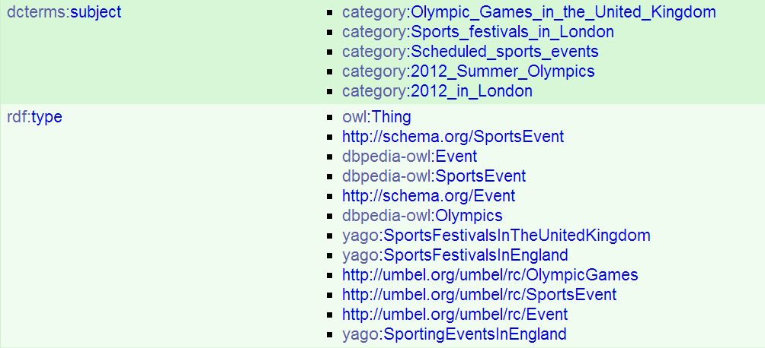
Discovering Semantically Similar Topics
Trending Topic: “Olympics 2012”
Notes:
Dbpedia is a knowledge base that is essentially a structured representation of the information on Wikipedia

Slide 44
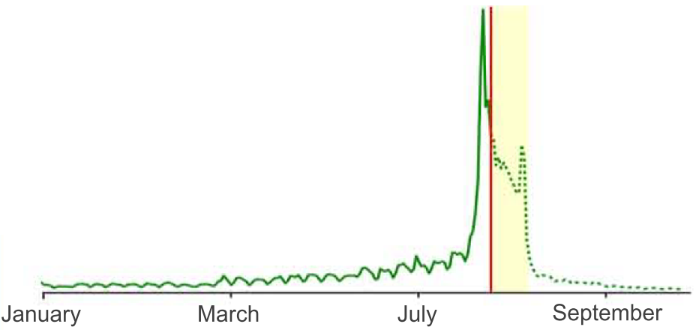
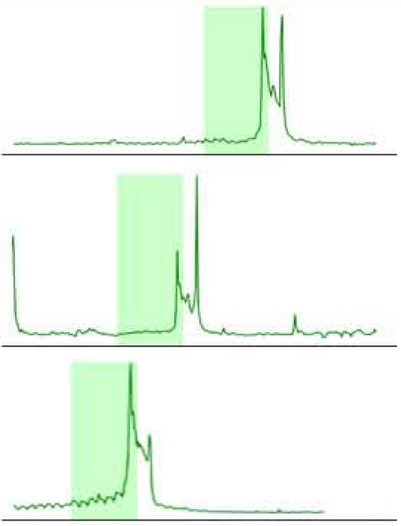
Nearest Neighbor Sequence Matching

Slide 45
Forecasting

Slide 46
Forecasting

Slide 47
Forecasting

Slide 48
Forecasting

Slide 49
Forecasting

Slide 50
Forecasting

Slide 51
Evaluation

Slide 52
Dataset
Public dataset of Wikipedia view statistics
Historical data from 2008 until today
Large-scale: 5 million articles attracting 870 million views each day
2.8 TB compressed
→ Semantic similarity between 5 million articles
→ 9 billion sequences to choose from
Use 200 top trending topics for evaluation

Slide 53
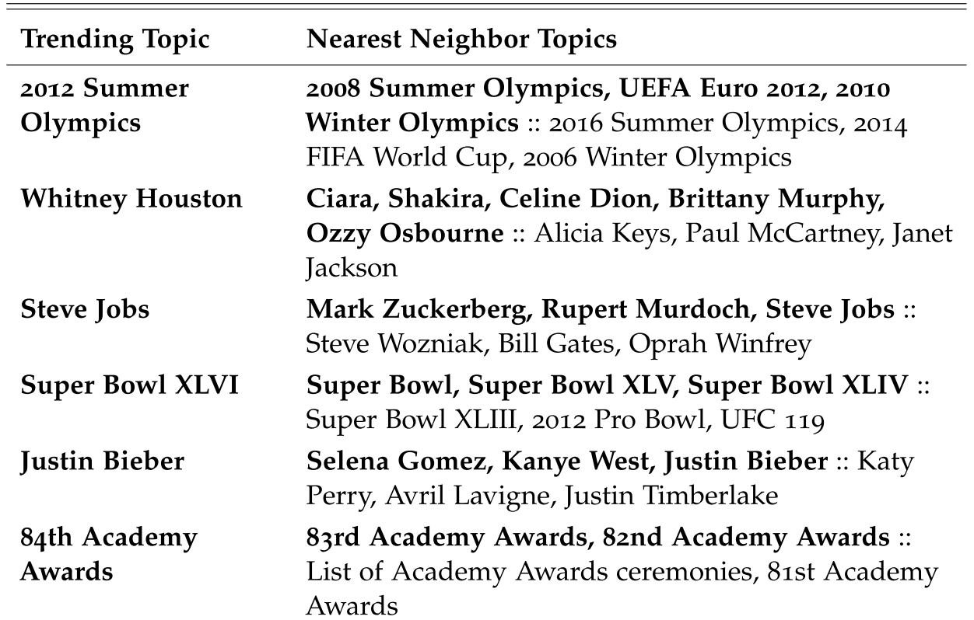
Discovering Semantically Similar Topics
Notes:
Bold: similar historical view behavior

Slide 54
Example: “The Hunger Games”

Slide 55
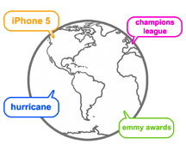
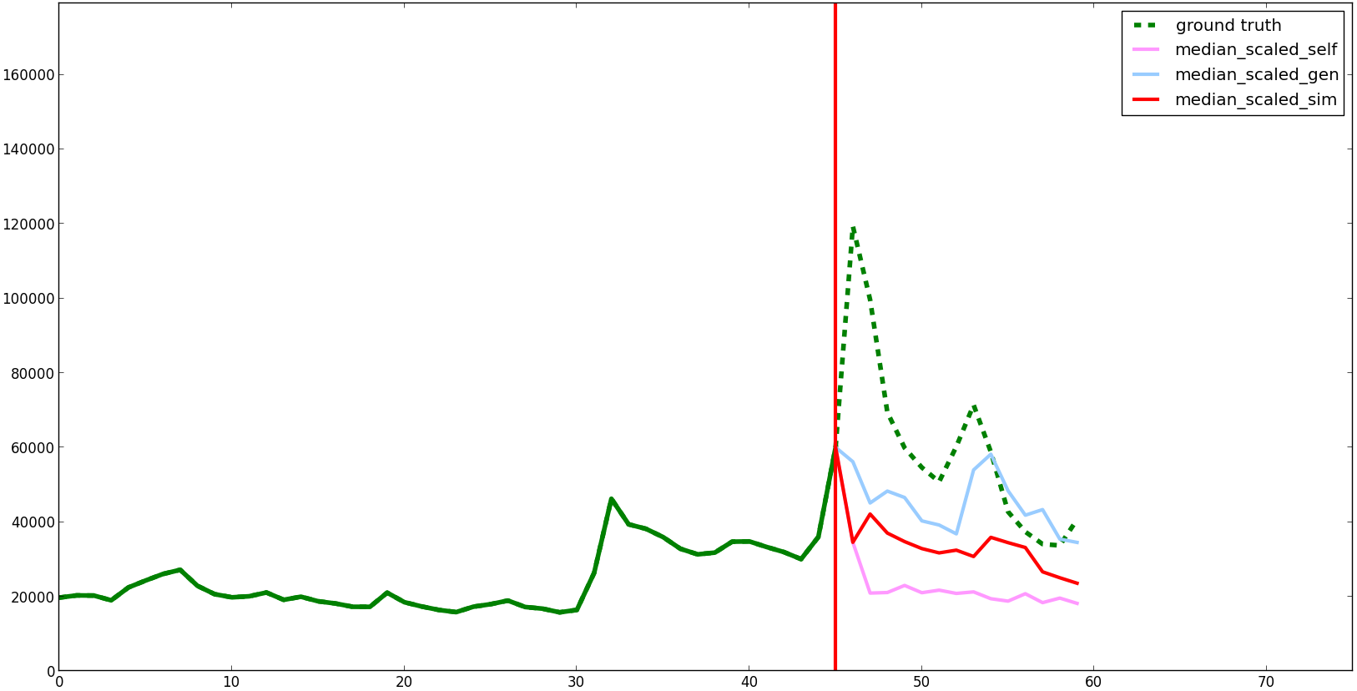
Example: “The Hunger Games”
Trending Topic Trigger
Different models
Wikipedia article views
Time in days
14 day horizon
Notes:
Note that we only show our models, no baselines, too many models
Go forth and back and then explain

Slide 56
Example: “The Hunger Games”

Slide 57
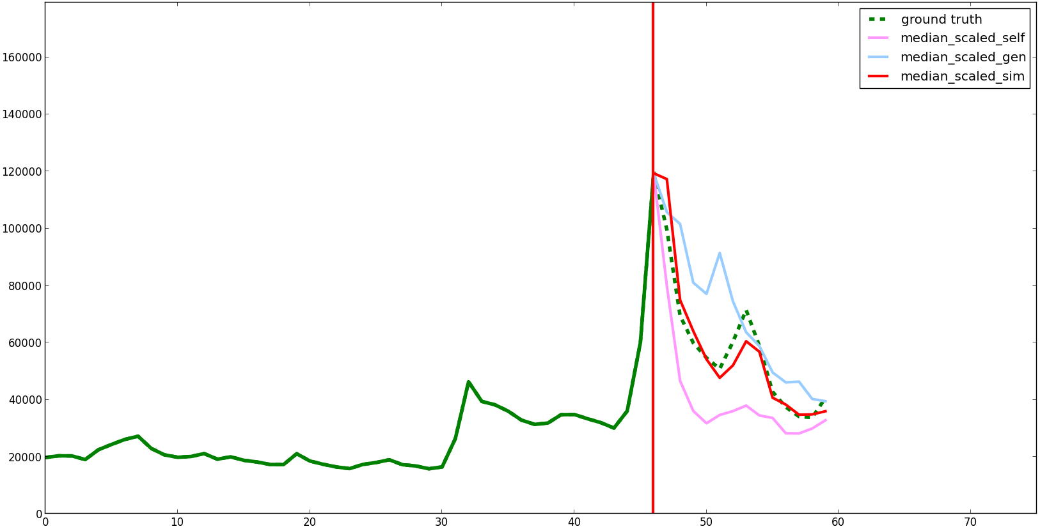
Example: “The Hunger Games”

Slide 58
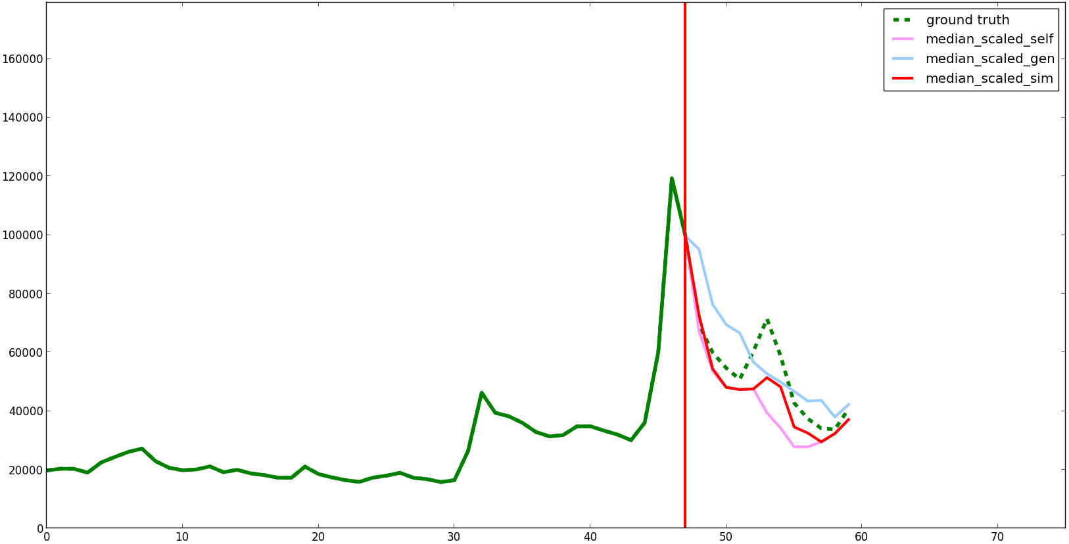
Example: “The Hunger Games”

Slide 59
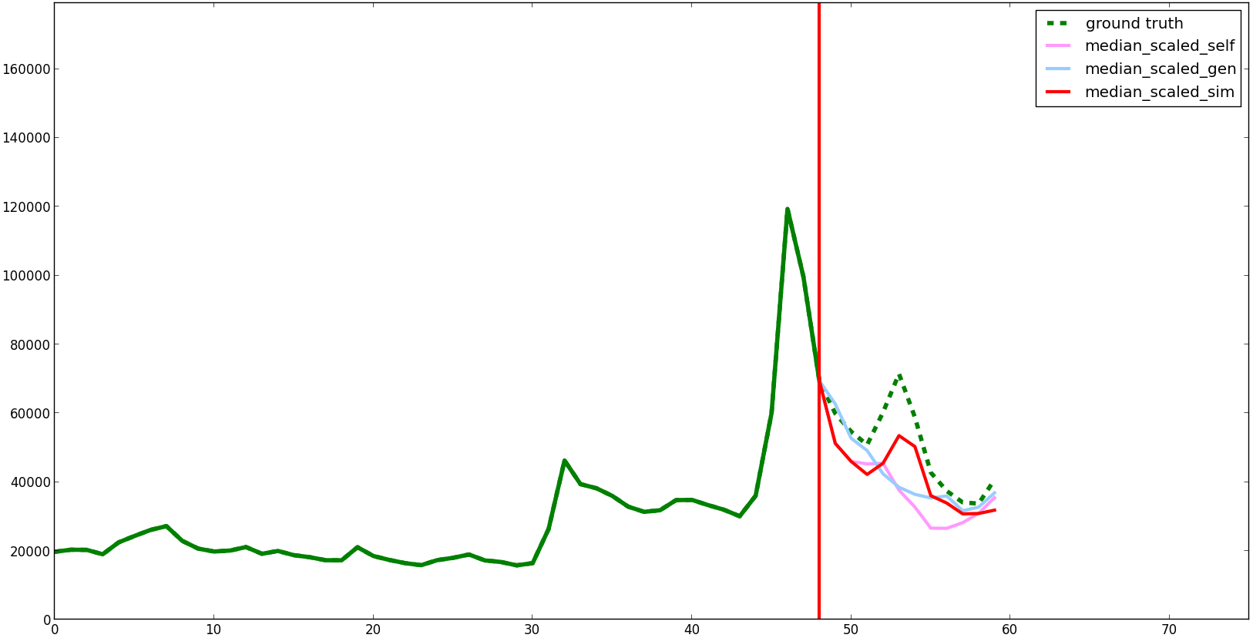
Example: “The Hunger Games”

Slide 60
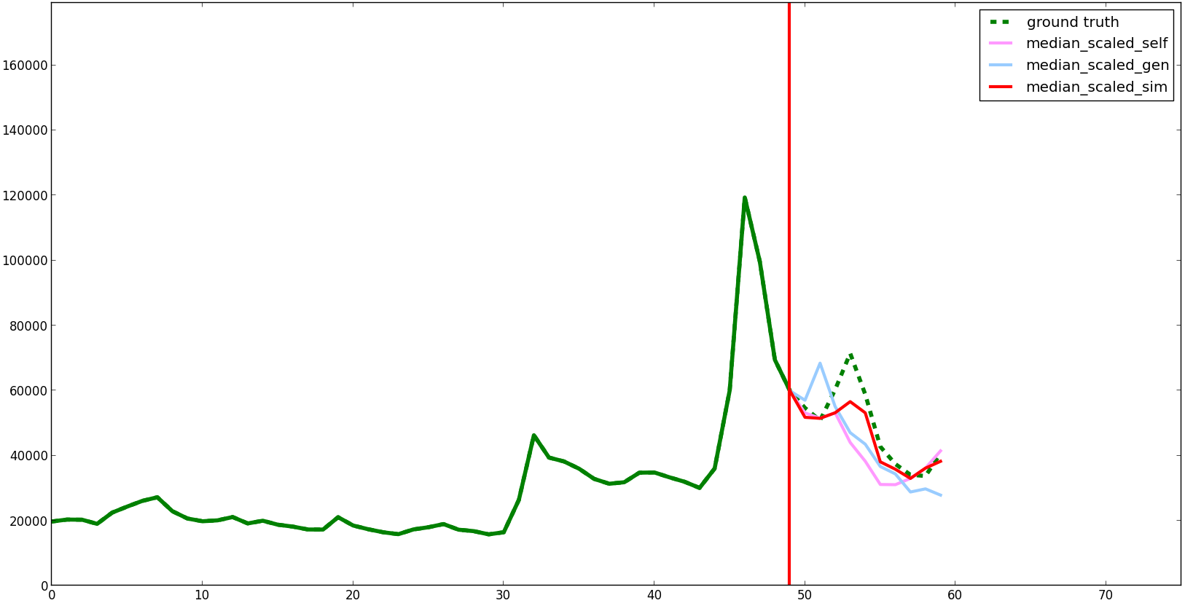
Example: “The Hunger Games”

Slide 61
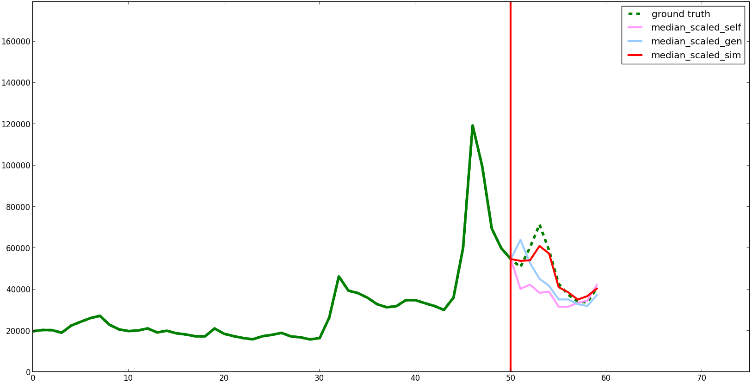
Example: “The Hunger Games”

Slide 62
Example: “The Hunger Games”

Slide 63
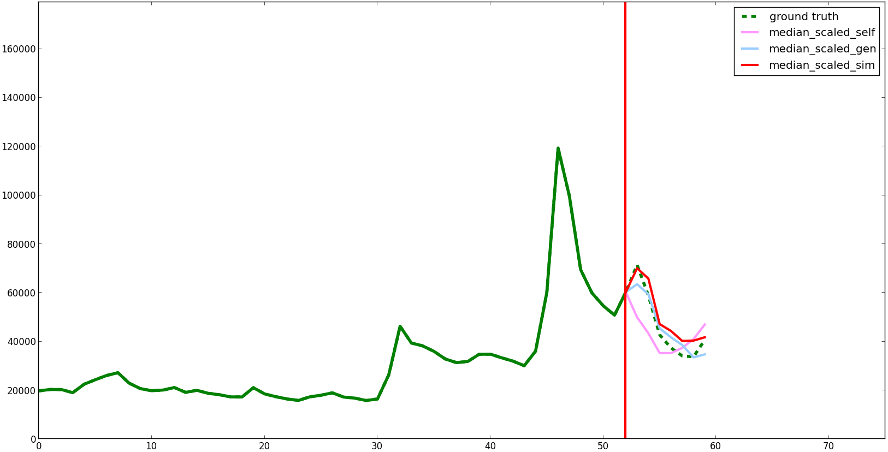
Example: “The Hunger Games”

Slide 64
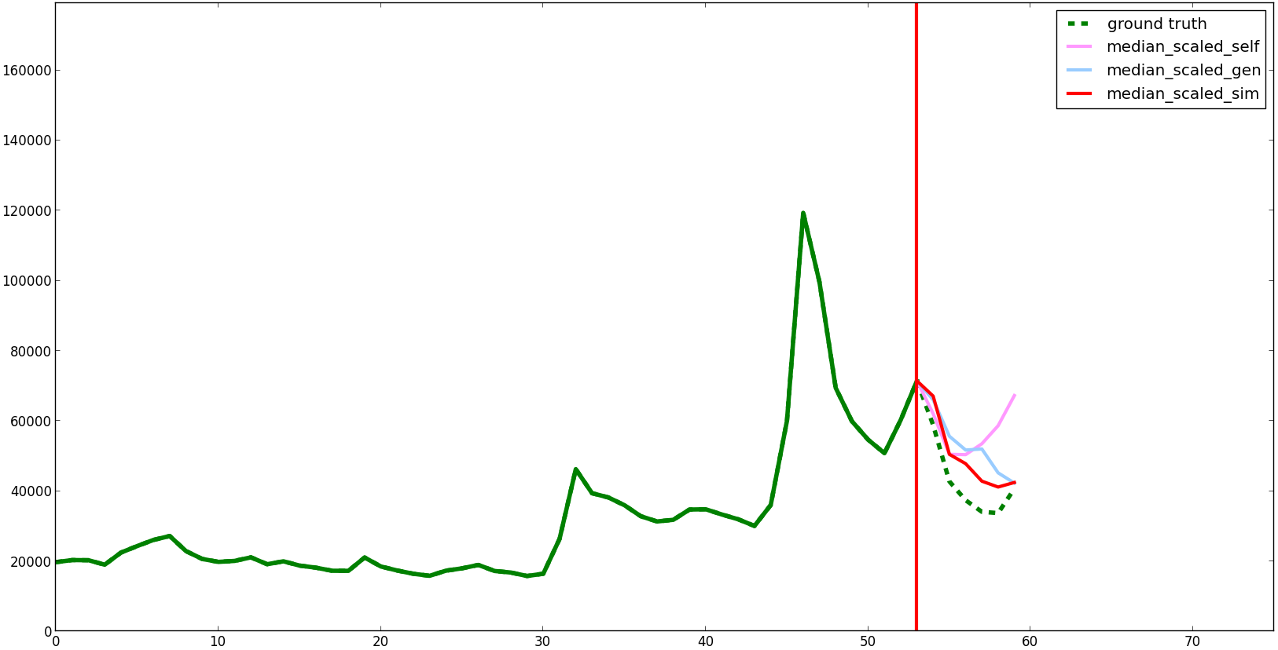
Example: “The Hunger Games”

Slide 65
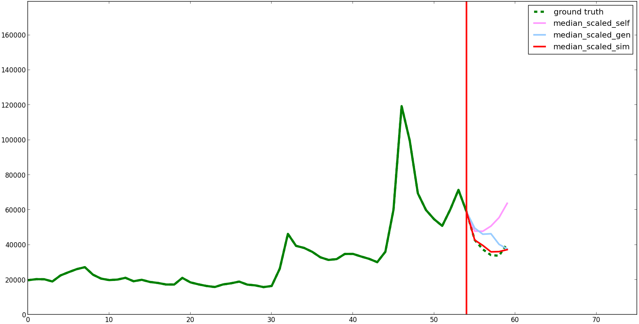
Example: “The Hunger Games”

Slide 66
Example: “The Hunger Games”

Slide 67
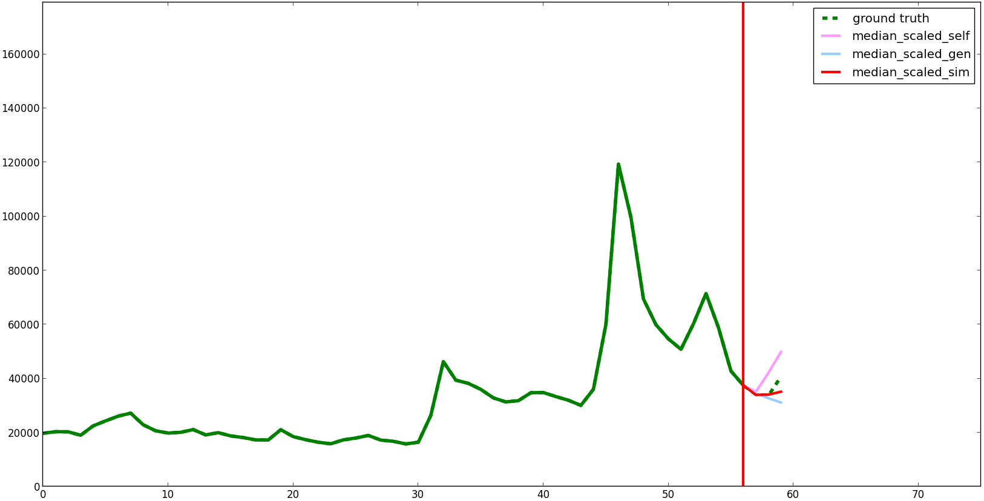
Example: “The Hunger Games”

Slide 68
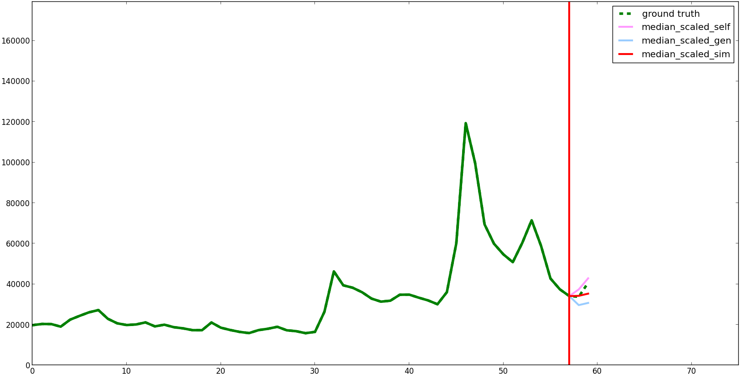
Example: “The Hunger Games”

Slide 69
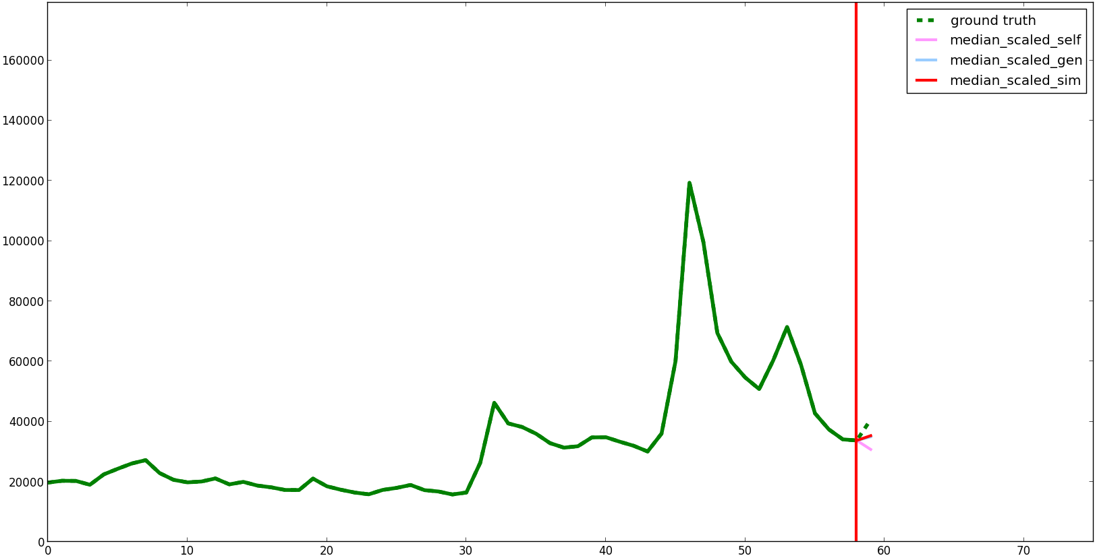
Example: “The Hunger Games”

Slide 70
Quantitative Results
Notes:
Now that you get the idea let's look at quantitative results over 500 different trending topic sequences

Slide 71
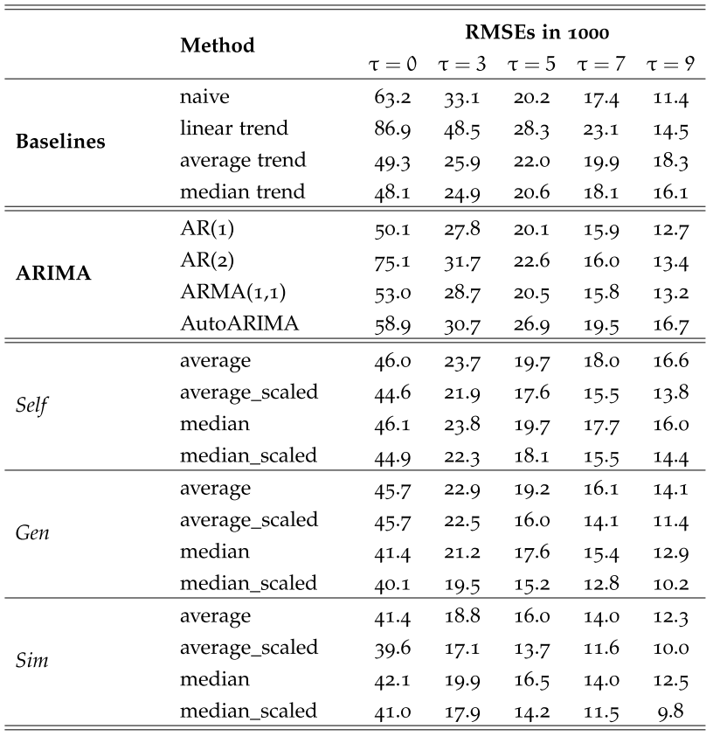
Root Mean Square Error

Slide 72
Root Mean Square Error

Slide 73
Root Mean Square Error

Slide 74
Mean Average Percentage Error

Slide 75
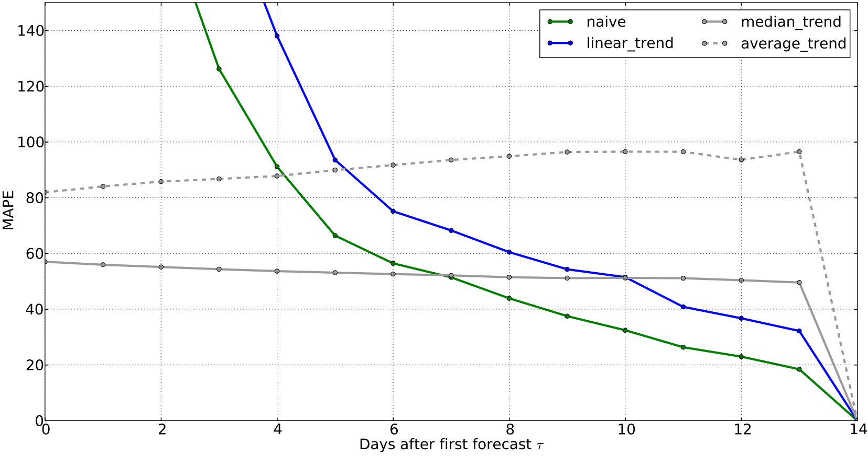
Mean Average Percentage Error
Notes:
e.g. arma not included to still visually distinguish the curves – however, not competitive with the best models here

Slide 76
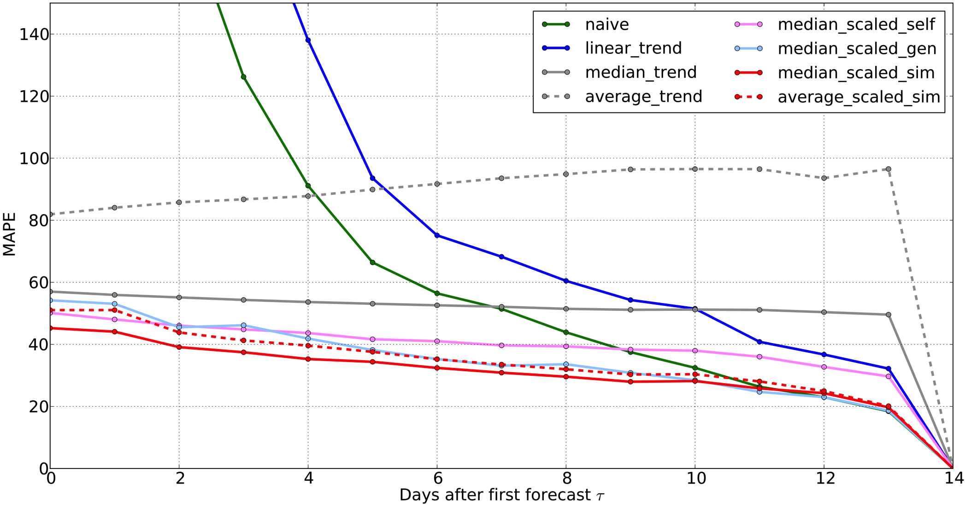
Mean Average Percentage Error
Notes:
e.g. arma not included to still visually distinguish the curves – however, not competitive with the best models here

Slide 77
Conclusion

Slide 78
Main Contributions
Multi-channel analysis of trending topics
Fully automatic forecasting technique exploiting semantic relationships between topics
Empirical evaluation on a large-scale Wikipedia dataset
Notes:
a study of trending topics in three major social and online media channels with an observation period of one year
a fully automatic forecasting technique based on a nearest neighbor approach exploiting semantic relationships between topics
an empirical evaluation of this forecasting model over real-world user behavior on a large-scale Wikipedia dataset

Slide 79
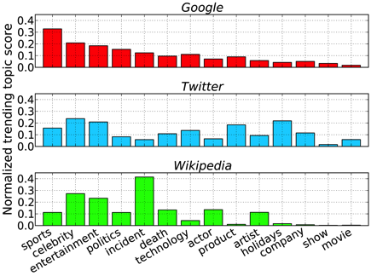
Insights
Trends on Twitter and Wikipedia are significantly more ephemeral than on Google.
All observed media channels tend to specialize in specific topic categories.
Semantically similar topics exhibit similar behavior.
Exploiting this observation can significantly improve forecasting performance (by 20-90% compared to baselines).

Slide 80
Acknowledgments

Slide 81
Questions?
Analysis and Forecasting of Trending Topics in Online Media Streams
Tim Althoff, Damian Borth, Jörn Hees, Andreas Dengel
Thank you for your attention

Slide 82
Backup Slides

Slide 83
Motivation
Big Data: “High volume, high velocity, and/or high variety information assets that require new forms of processing to enable enhanced decision making, insight discovery and process optimization”
Large-scale user behavior
„Mirror of Society“
[Mark A. Beyer and Douglas Laney. The importance of ’big data’: A deﬁnition. June 2012.]
Notes:
83

Slide 84
Large-scale Record of Human Behavior
1.2 million video minutes per second (est. 2016)
Primary method for communication by college students in the U.S.
25 million articles and 1.8 billion page edits in 285 languages created by 100k contributors
340 million tweets each day by 500 million users
One billion search requests and about twenty petabytes of user-generated data each day (2009)
Notes:
Twitter users in New York city were seeing tweets about the 2011 Washington D.C. earthquake half a minute before they could even feel it

Slide 85
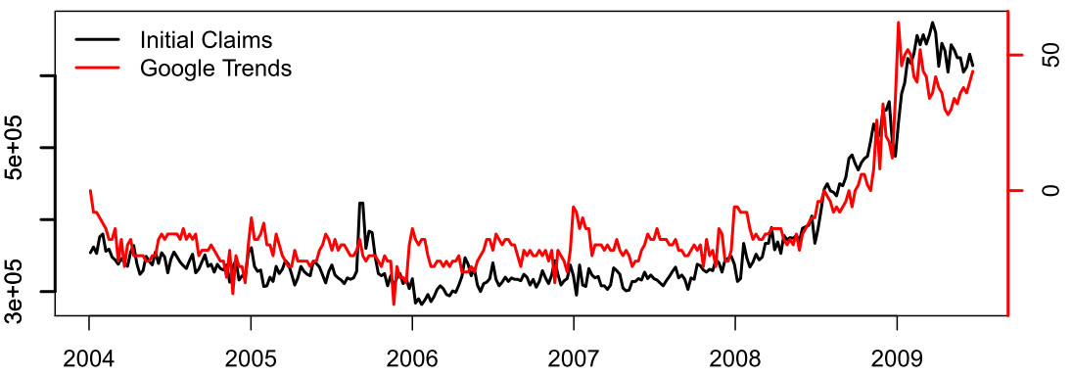
Unemployment Claims
jobs
[Choi and Varian. Predicting initial claims for unemployment benefits. Google, Inc. 2009.]
Notes:
The “Initial Jobless Claims” is a weekly report issued by US Department of Labor. i. It
tracks the number of people ﬁled for the unemployment beneﬁts and it is considered a leading indicator of labor market. The claims are reported at the national and state level and the data data is available from ﬁrst week of 1987. Advance initial claims weekly reports at the national level data are released 5 days after the week ends.

Slide 86
What is the world talking about?
Social Media can offer insights in
what the world is talking about
how people feel about events, brands and products
resulting in an collective awareness for trending topics
A trending topic
is a subject matter of discussion agreed on by a group of people
experiences a sudden spike in user interest or engagement
[Damian Borth, Adrian Ulges, Thomas Breuel. Dynamic Vocabularies for Web-based Concept Detection by Trend Discovery. ACM Multimedia, 2012]

Slide 87
Trending Topics Discovery
Notes:
87

Slide 88
Trending Topics Discovery
Notes:
88

Slide 89
Lifetime Analysis
Notes:
89

Slide 90
Lifetime Analysis
Notes:
90

Slide 91
Lifetime Analysis
Notes:
91

Slide 92
Lifetime Analysis
Notes:
92

Slide 93
Example 2: “Battlefield 3”

Slide 94
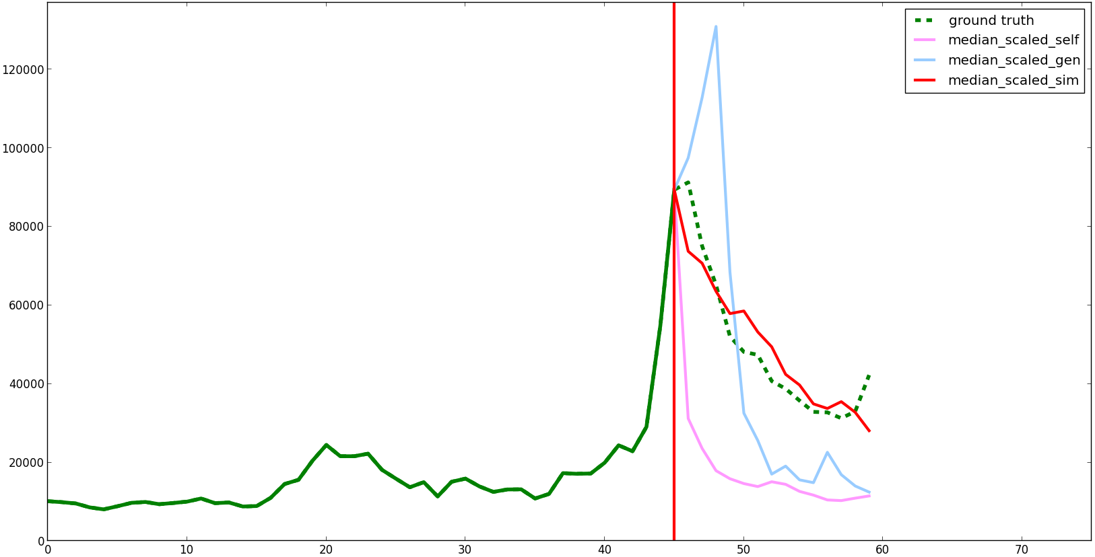
Example 2: “Battlefield 3”
Trending Topic Trigger
Wikipedia article views
Time in days
14 day horizon

Slide 95
Example 2: “Battlefield 3”

Slide 96
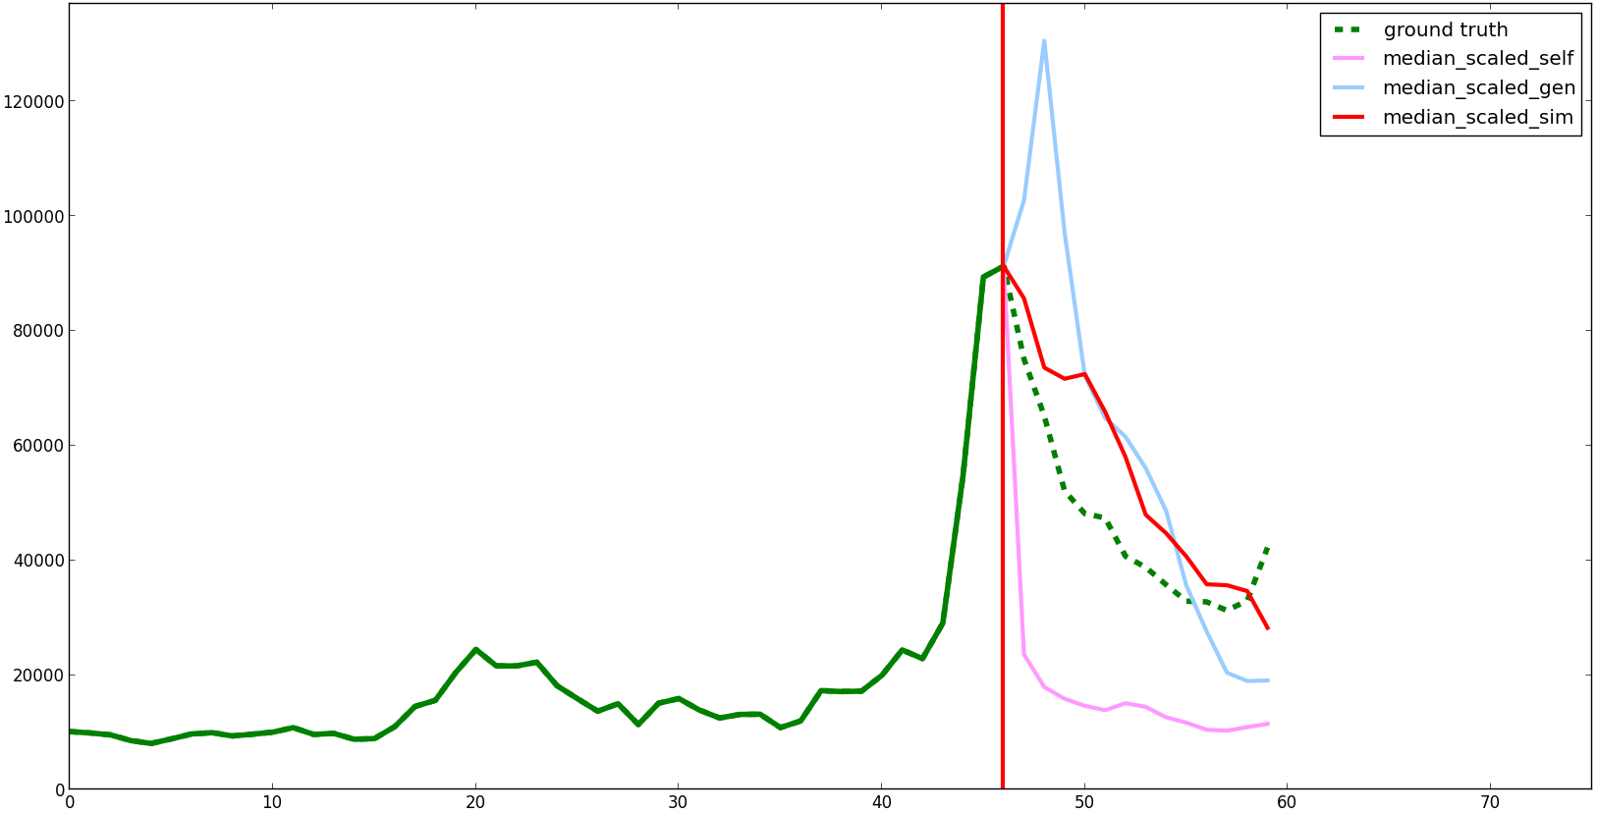
Example 2: “Battlefield 3”

Slide 97
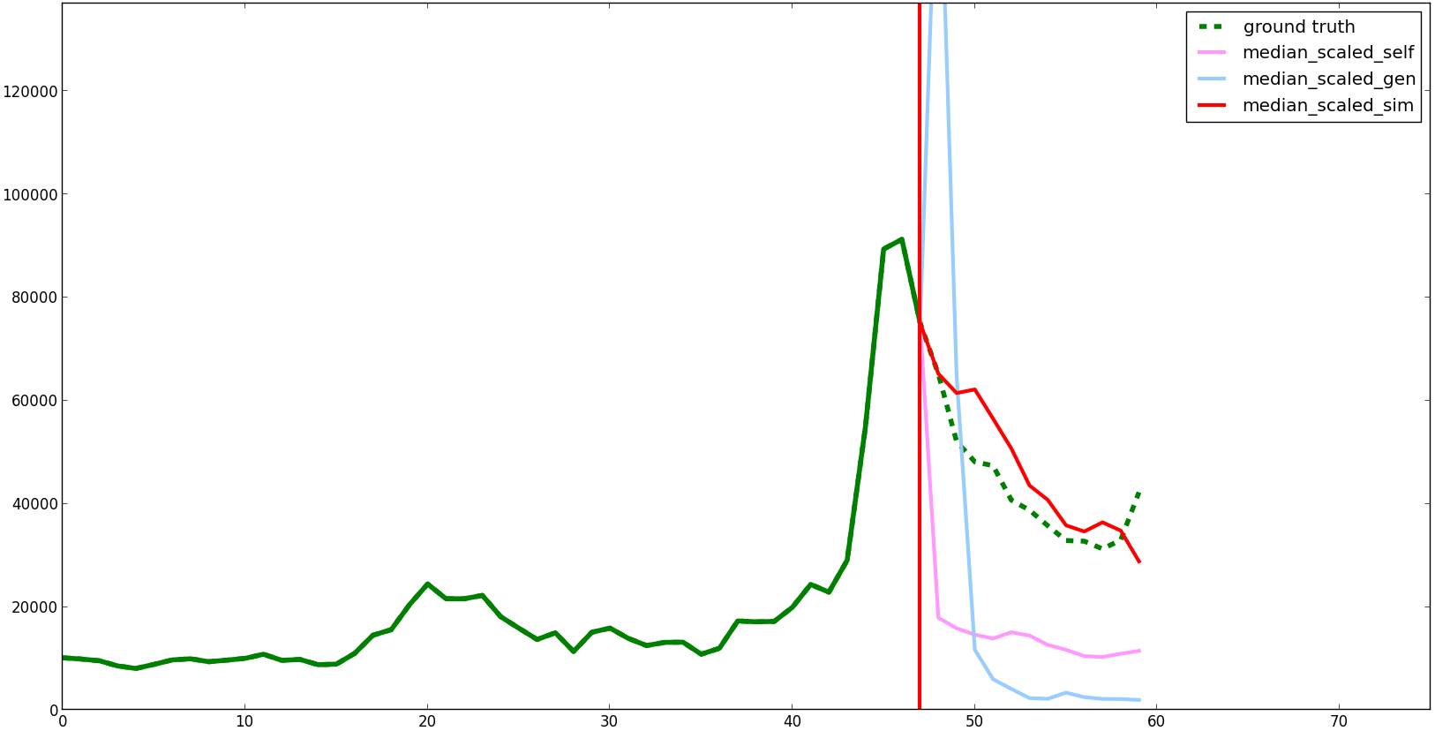
Example 2: “Battlefield 3”

Slide 98
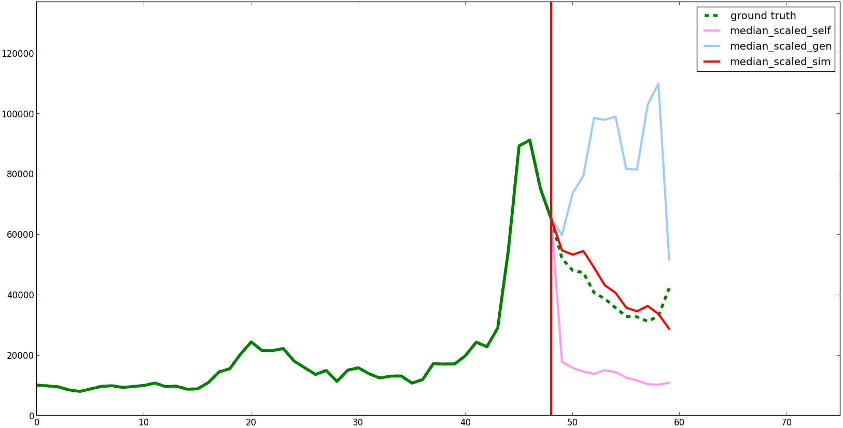
Example 2: “Battlefield 3”

Slide 99
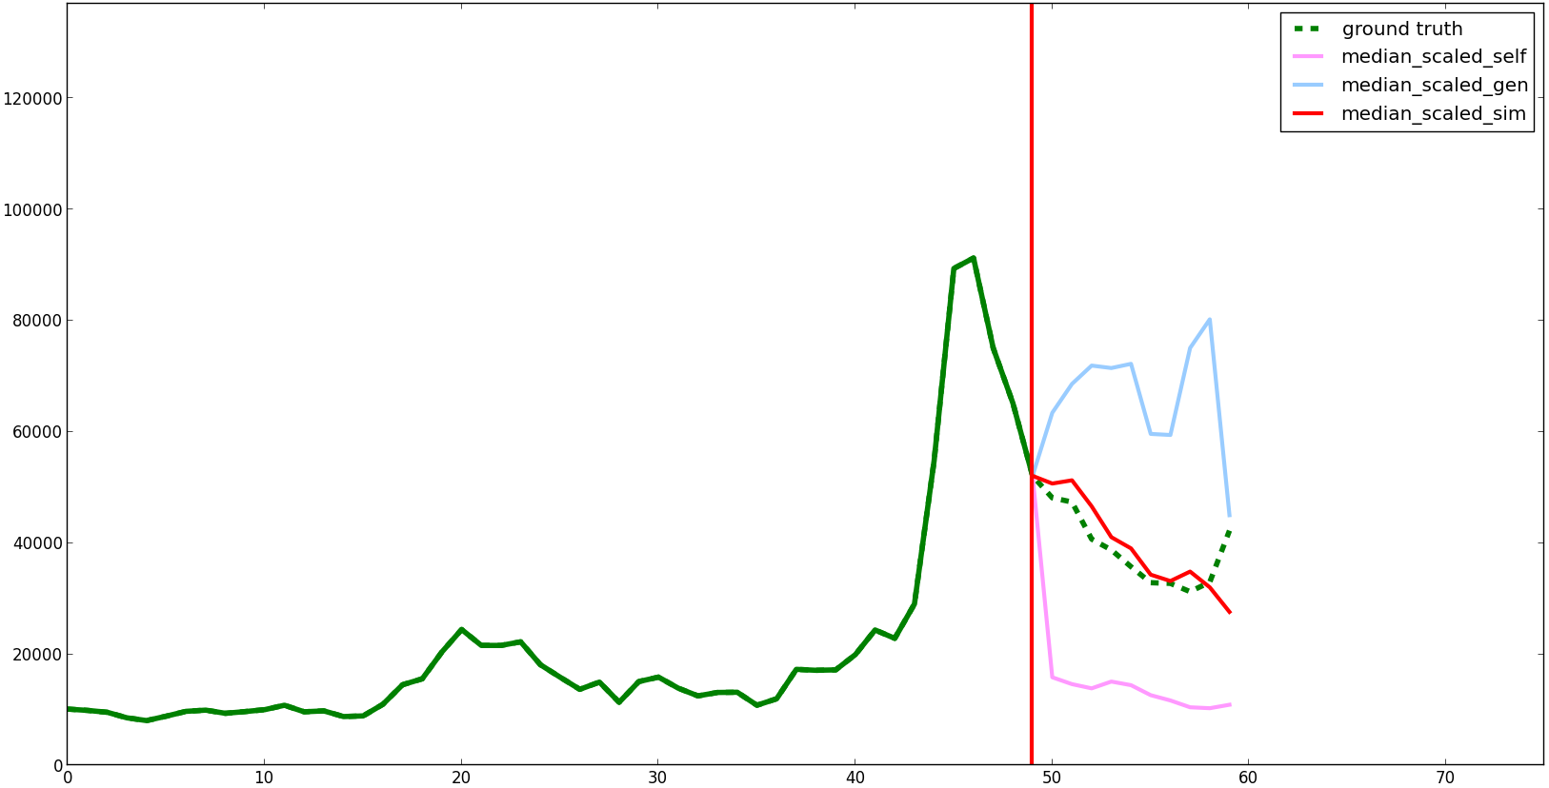
Example 2: “Battlefield 3”

Slide 100
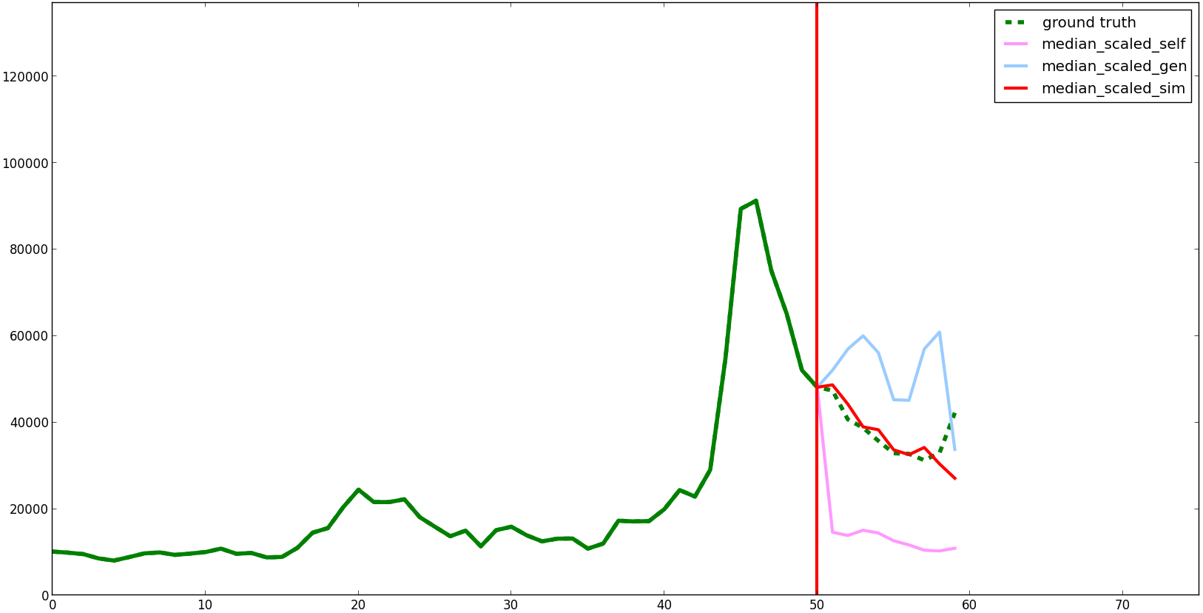
Example 2: “Battlefield 3”

Slide 101
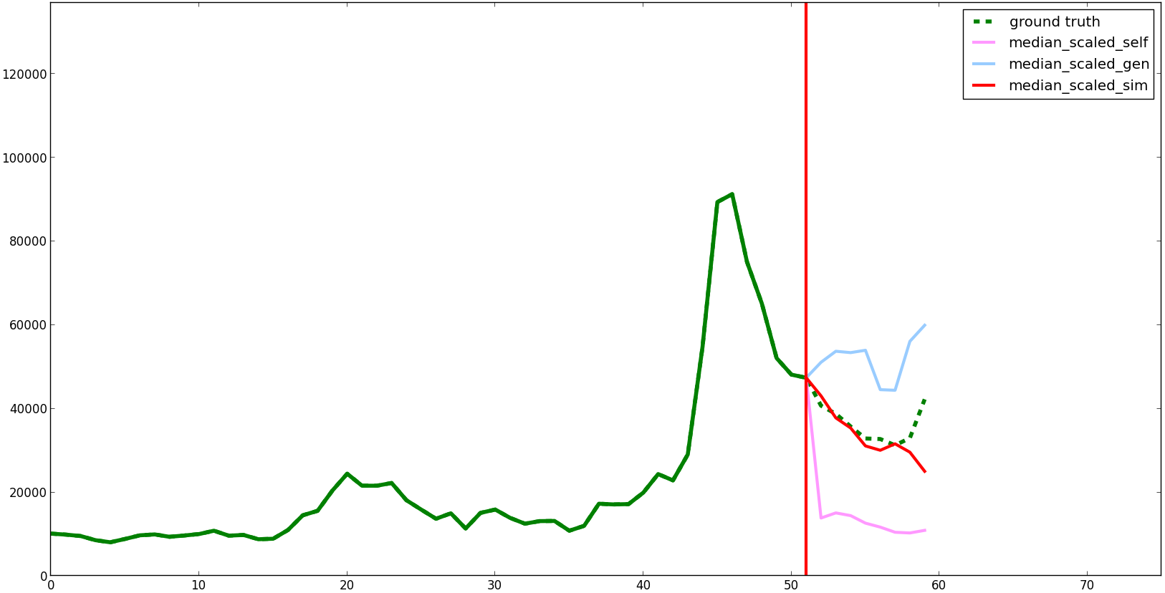
Example 2: “Battlefield 3”

Slide 102
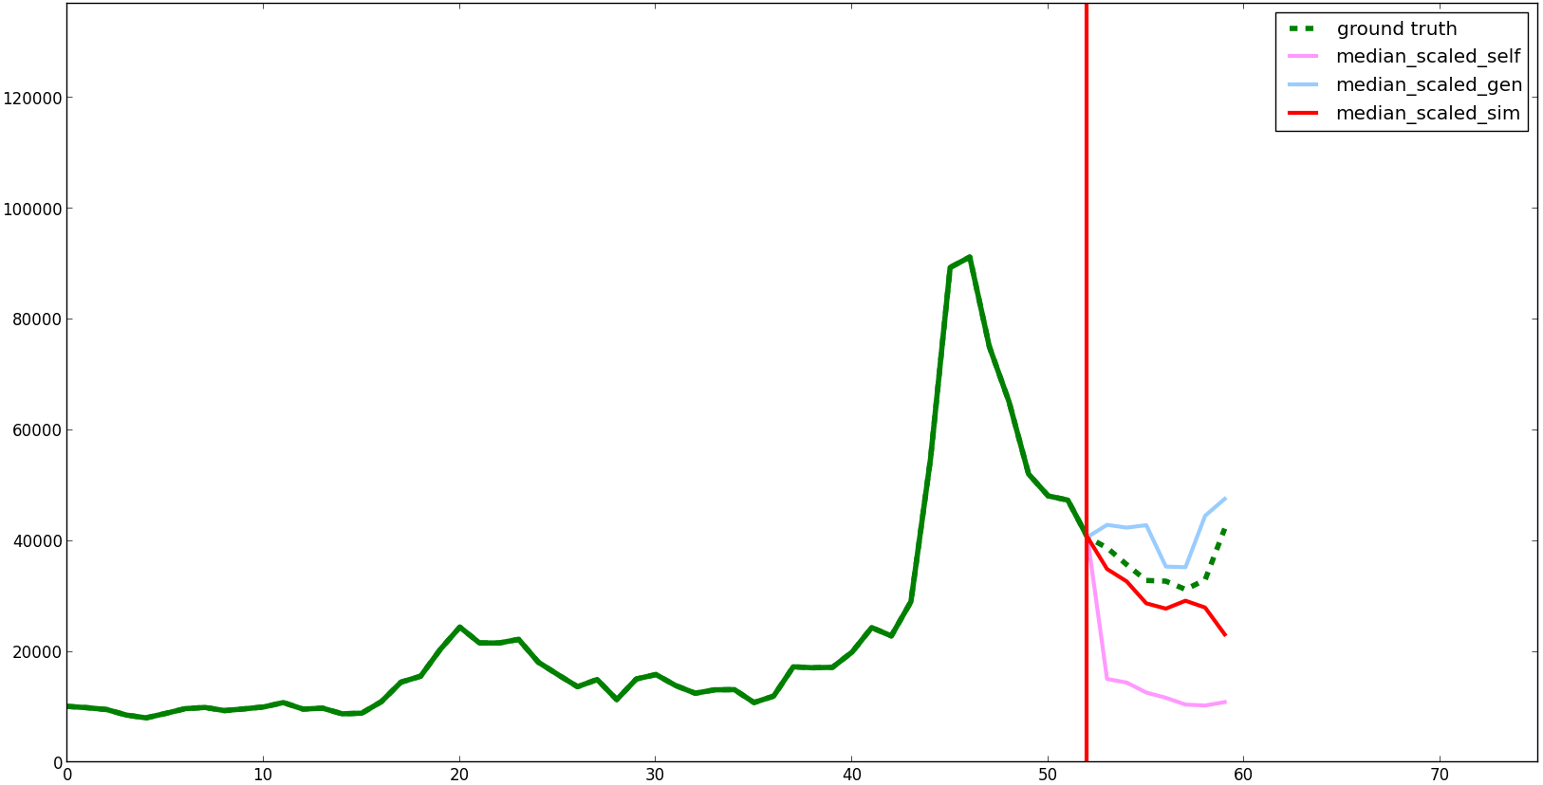
Example 2: “Battlefield 3”

Slide 103
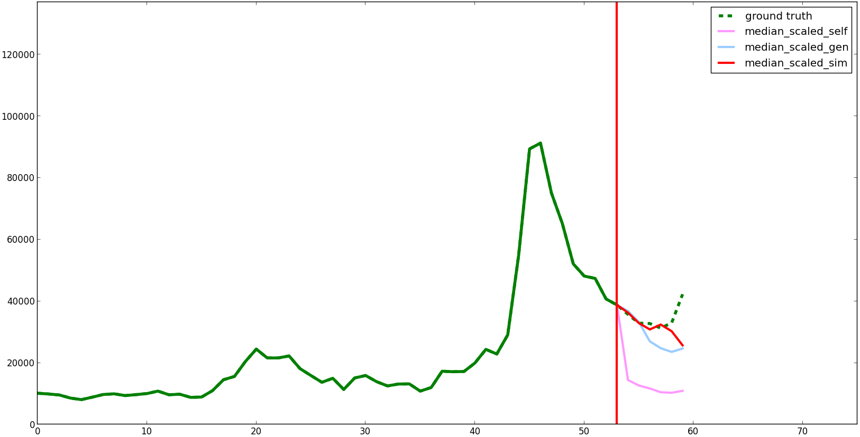
Example 2: “Battlefield 3”

Slide 104
Example 2: “Battlefield 3”

Slide 105
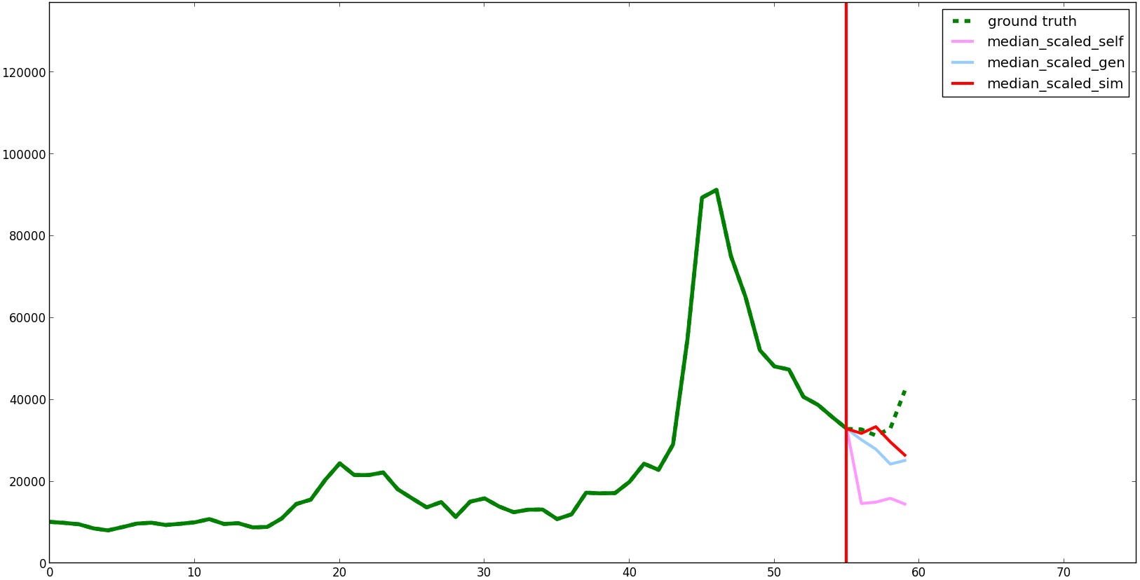
Example 2: “Battlefield 3”

Slide 106
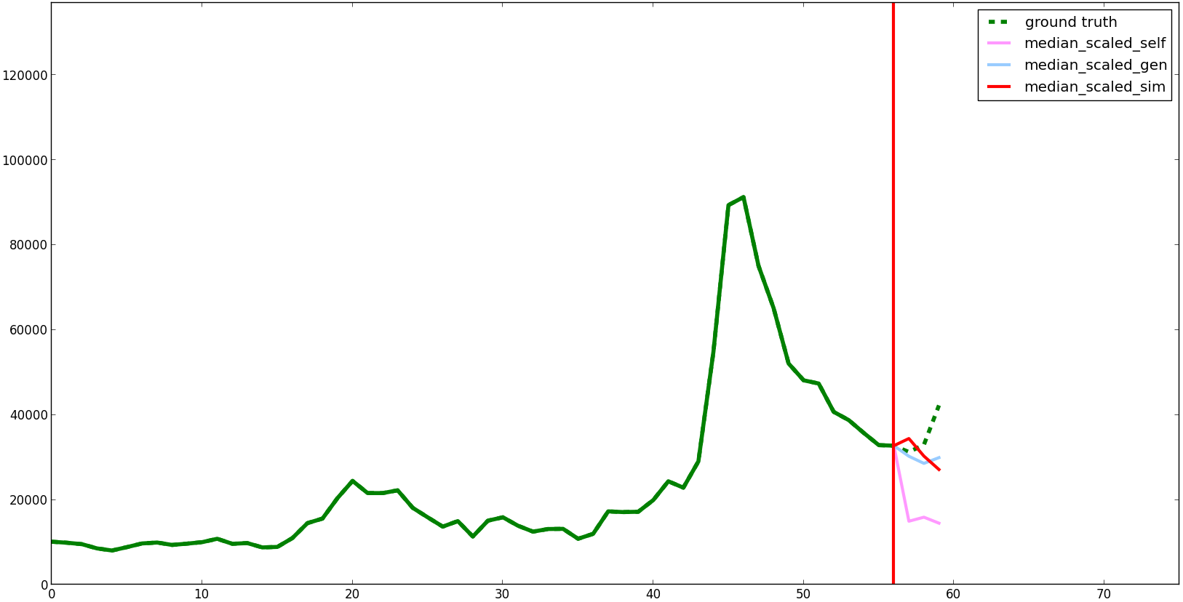
Example 2: “Battlefield 3”

Slide 107
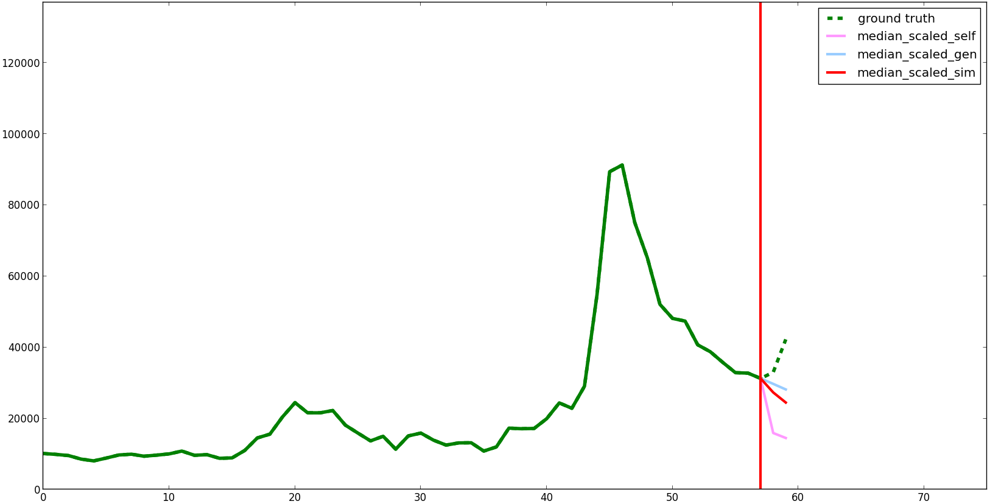
Example 2: “Battlefield 3”

Slide 108
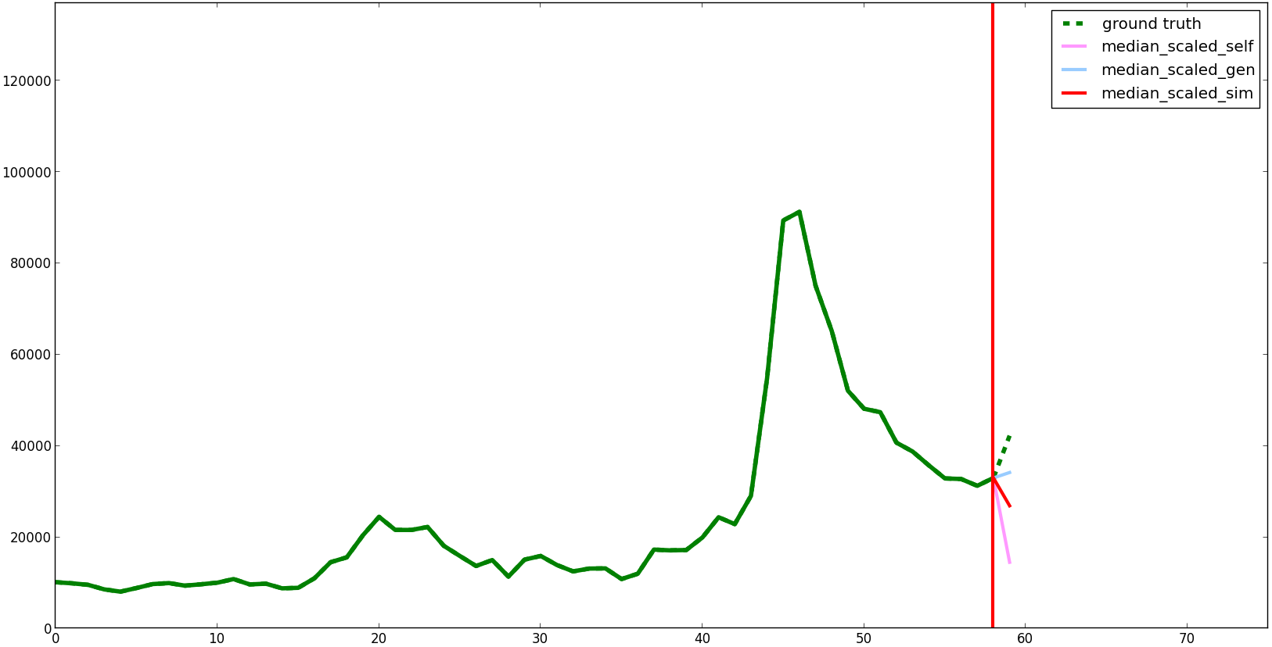
Example 2: “Battlefield 3”

